Slide 1
TSWG
Retired
Proposed
Incubation
Balloting
Accepted
Recommendation

Slide 2
SDO
Recommendation
TSWG Deliverables
ToIP Deliverables
Specs
TIP
Tech
Impls
Layer Interop APIs
TSS
Aries
TSS: Layer 1-2 API
TIP Repo 1
TIP Repo 2
Aries
TSS: Layer 2-3 API
General Arch
TIP Repo 3
Layer Interop APIs
TSS: Layer 3-4 API
Domain Specific Language

Slide 3
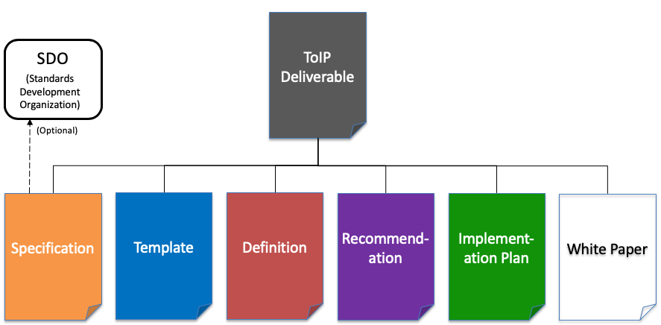
ToIP Deliverables

Slide 4
ToIP Deliverables - JDF Process
Deliverables
Specifications
Template
Definition
Recommendation
Implementation Plans
White Paper
trustoverip/sc
Stage One: Draft Deliverable
Stage Two: Working Group Approved Deliverable
Stage Three: Steering Committee Approved Deliverable
SDO
Submission

Slide 5
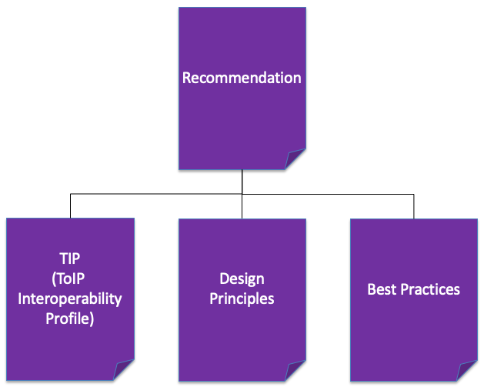
ToIP Deliverables - Recommendation Types

Slide 6
TSWG Deliverables Types
Layer Interop Specs
TIP

Slide 7
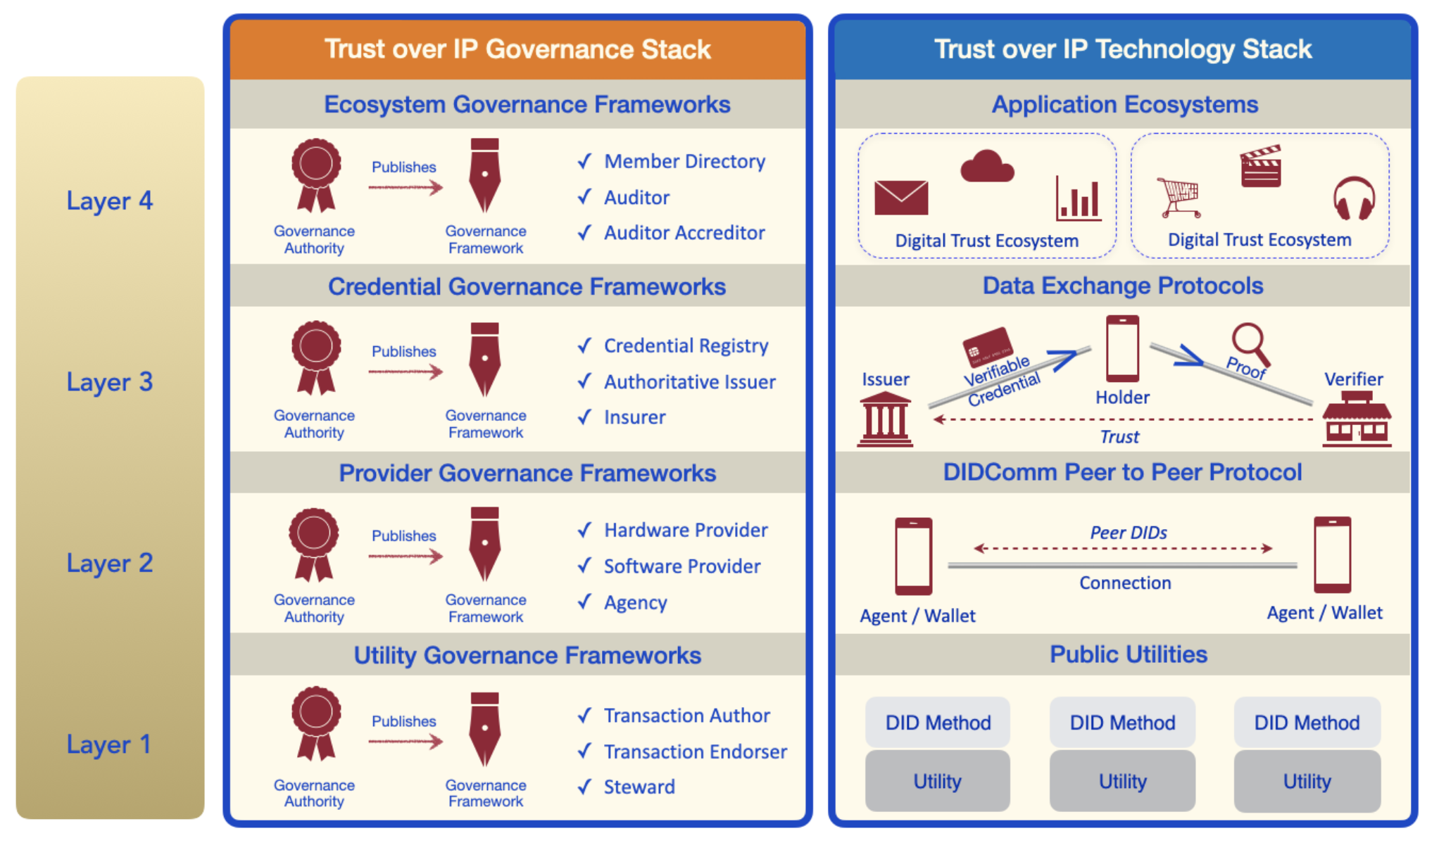
ToIP Deliverables - Layer Interop Specifications
Specifications
Layer 3 Interop Specification
Layer Interop Specification
Layer 2 Interop Specification
Layer 1 Interop Spec
Layer 2 Interop Spec
Layer 3 Interop Spec
Layer 1 Interop Specification
Since Machine Readable Governance Frameworks are possible, we must consider API deliverables from both GSWG and TSWG.

Slide 8
TSWG Lifecycle Management
Deliverables | Proposed | Incubating | Balloting | Accepted | Retired
TIP
Layer Interop Specs
Graduation Submission
Working Group Approved Deliverable

